Slide 1
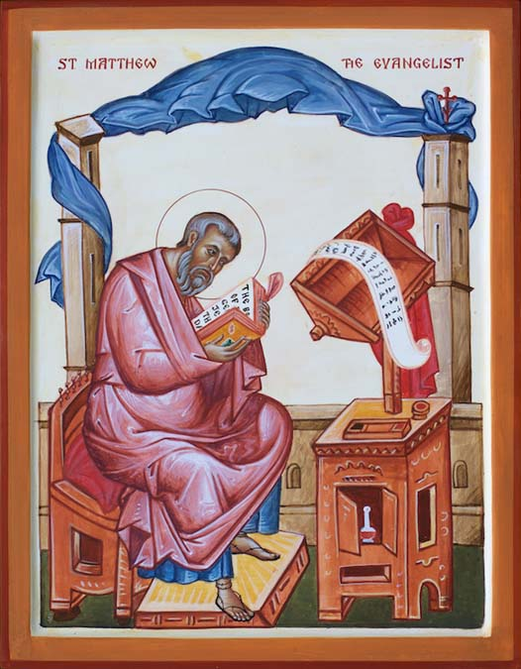
The story of Jesus’ birth
By
St Matthew

Slide 2
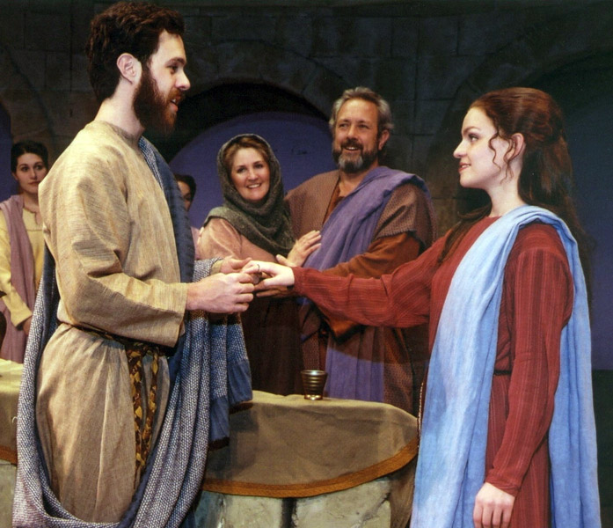
This is how Jesus Christ was born. A young woman named Mary was engaged to Joseph from King David’s family.

Slide 3
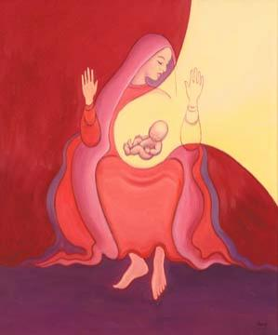
But before they were married, she learned that she was going to have a baby by God’s Holy Spirit.

Slide 4
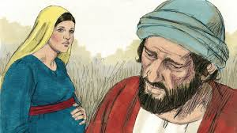
Joseph was a good man and did not want to embarrass Mary in front of everyone. So he decided to quietly call off the wedding.

Slide 5
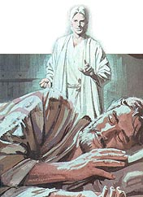
While Joseph was thinking about this, an angel from the Lord came to him in a dream. The angel said, “Joseph, the baby that Mary will have is from the Holy Spirit. Go ahead and marry her.

Slide 6
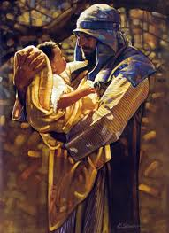
Then after her baby is born, name him Jesus, because he will save his people from their sins.” So the Lord’s promise came true, just as the prophet had said, “A virgin will have a baby boy, and he will be called Immanuel,” which means “God is with us.”

Slide 7
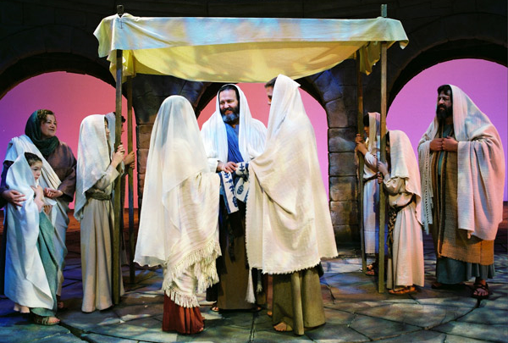
After Joseph woke up, he and Mary were soon married, just as the Lord’s angel had told him to do. But they did not sleep together before her baby was born.

Slide 8
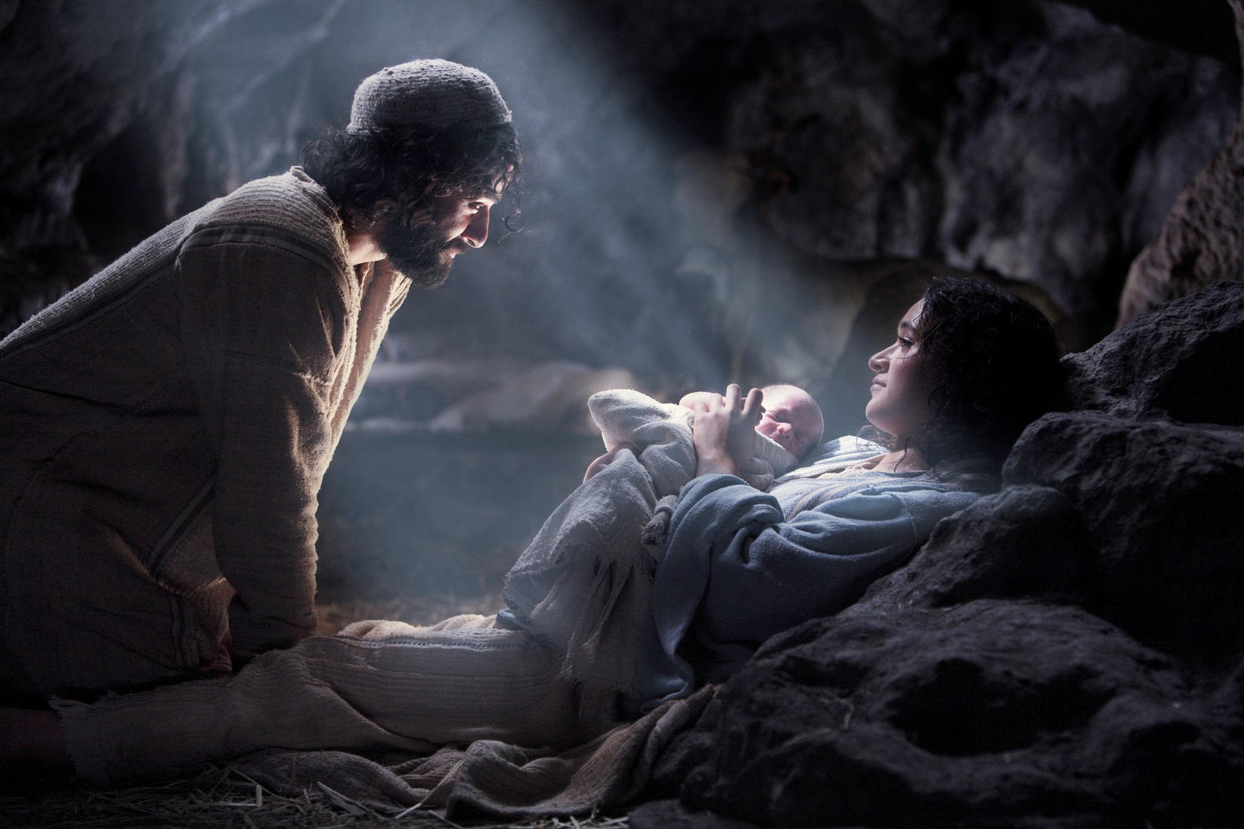
Then Joseph named him Jesus.

Slide 9
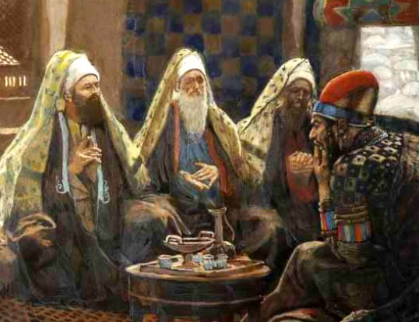
When Jesus was born in the village of Bethlehem in Judea, Herod was king.
During this time some wise men from the east came to Jerusalem and said, “Where is the child born to be king of the Jews? We saw his star in the east and have come to worship him.”

Slide 10
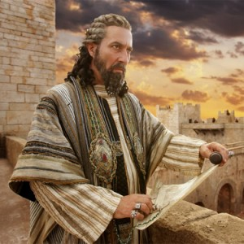
When King Herod heard about this, he was worried, and so was everyone else in Jerusalem. Herod brought together the chief priests and the teachers of the Law of Moses and asked them, “Where will the Messiah be born?”

Slide 11
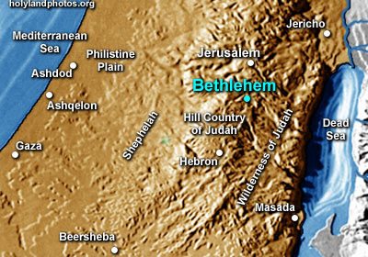
They told him, “He will be born in Bethlehem, just as the prophet wrote, ’Bethlehem in the land of Judea, you are very important among the towns of Judea. From your town will come a leader, who will be like a shepherd for my people Israel.’”

Slide 12
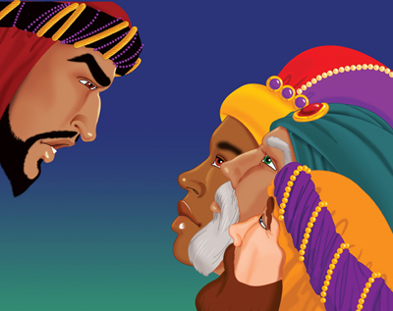
Herod secretly called in the wise men and asked them when they had first seen the star. He told them, “Go to Bethlehem and search carefully for the child. As soon as you find him, let me know. I want to go and worship him too.”

Slide 13
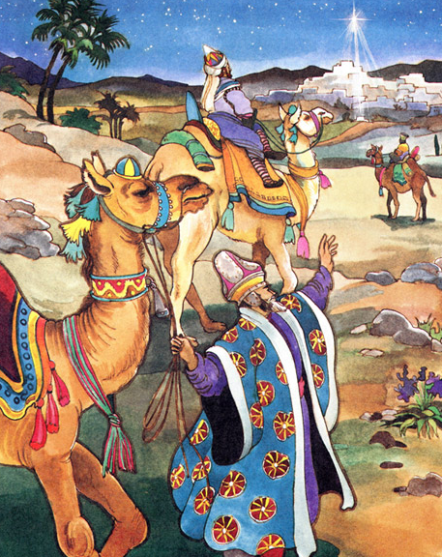
The wise men listened to what the king said and then left. And the star they had seen in the east went on ahead of them until it stopped over the place where the child was. They were thrilled and excited to see the star.

Slide 14
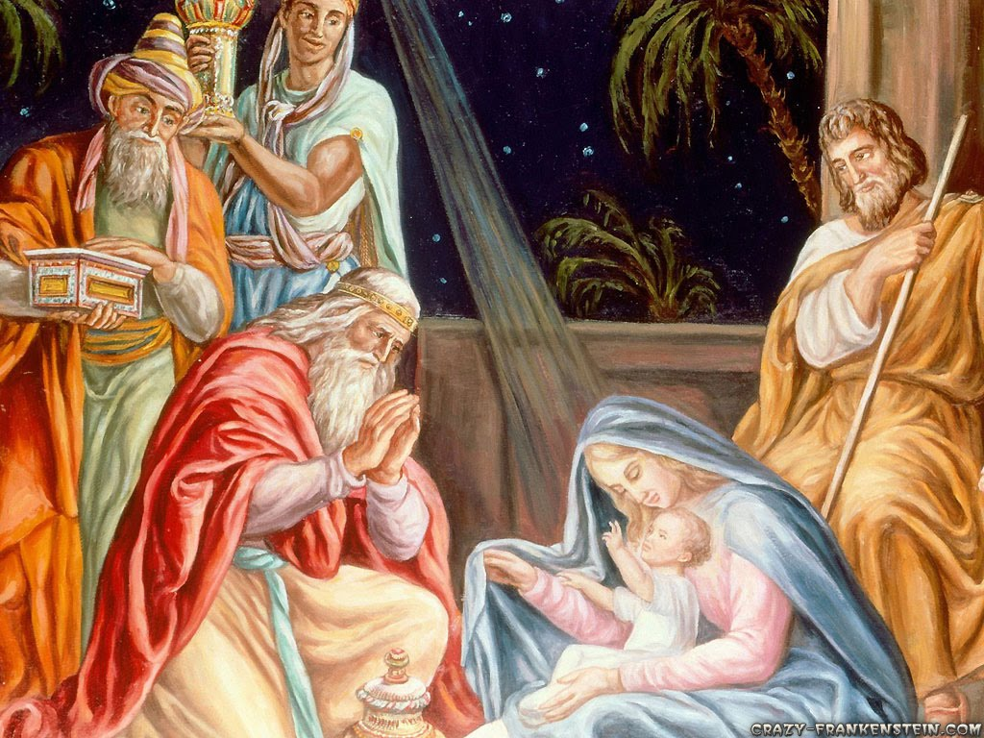
When the men went into the house and saw the child with Mary, his mother, they knelt down and worshiped him. They took out their gifts of gold, frankincense, and myrrh and gave them to him.

Slide 15
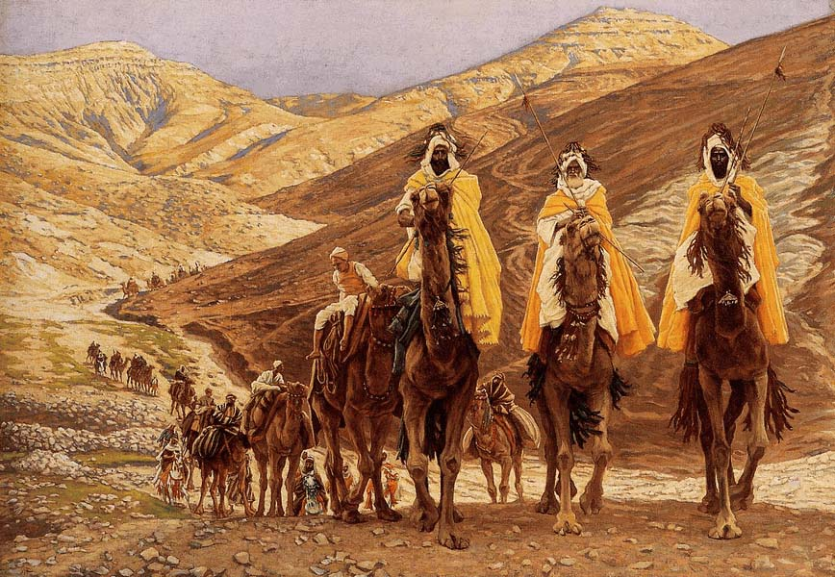
Later they were warned in a dream not to return to Herod, and they went back home by another road.

Slide 16
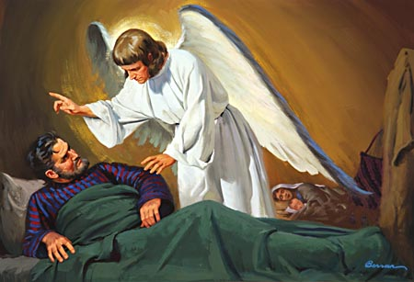
After the wise men had gone, an angel from the Lord appeared to Joseph in a dream and said, “Get up! Hurry and take the child and his mother to Egypt! Stay there until I tell you to return, because Herod is looking for the child and wants to kill him.”

Slide 17
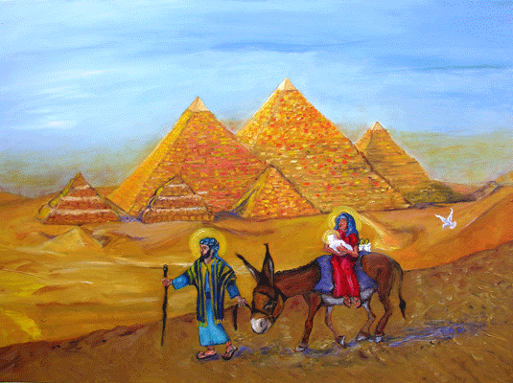
That night, Joseph got up and took his wife and the child to Egypt, where they stayed until Herod died. So the Lord’s promise came true, just as the prophet had said, “I called my son out of Egypt.”

Slide 18
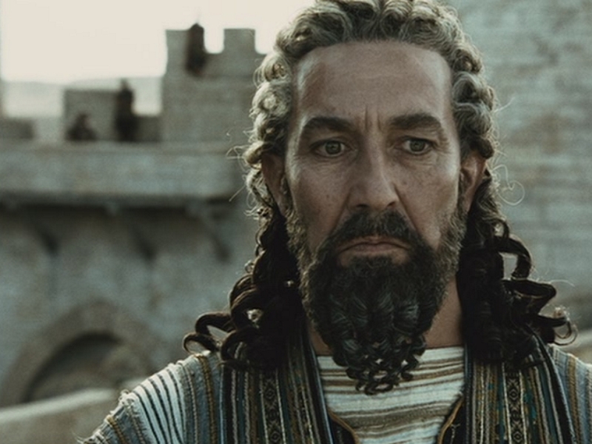
When Herod found out that the wise men from the east had tricked him, he was very angry.
He gave orders for his men to kill all the boys who lived in or near Bethlehem and were two years old and younger. This was based on what he had learned from the wise men.

Slide 19
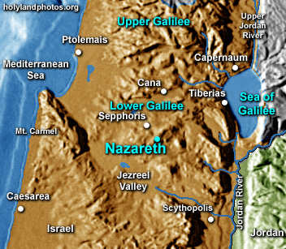
After King Herod died, an angel from the Lord appeared in a dream to Joseph while he was still in Egypt. The angel said, “Get up and take the child and his mother back to Israel. The people who wanted to kill him are now dead.”

Slide 20
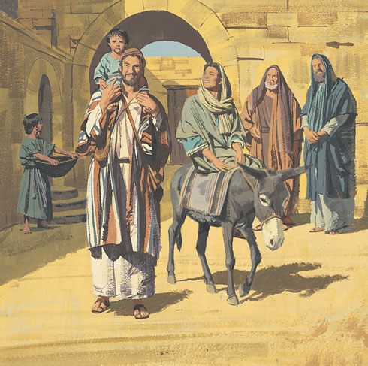
Joseph got up and left with them for Israel. But when he heard that Herod’s son Archelaus was now ruler of Judea, he was afraid to go there. Then in a dream he was told to go to Galilee, and they went to live there in the town of Nazareth. So the Lord’s promise came true, just as the prophet had said, “He will be called a Nazarene.”

